Slide 1


Market & Retail Analytics for Coffee Shop

Slide 2
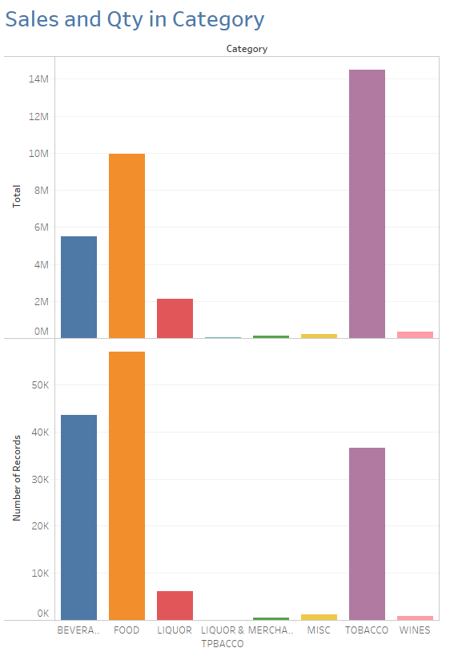
Popular Category in Sales
Sales in Revenue :
Most Sales are in Tobacco category – 14.5 Millions in sales
Food & Beverages are the next spot for sales
Least sales are captured in merchandise category
New list of category Liquor & Tobacco added in 2011
Sales and number of records
Most items are sold in Food category
Beverage and Tobacco is next in spot for most sold items

Slide 3
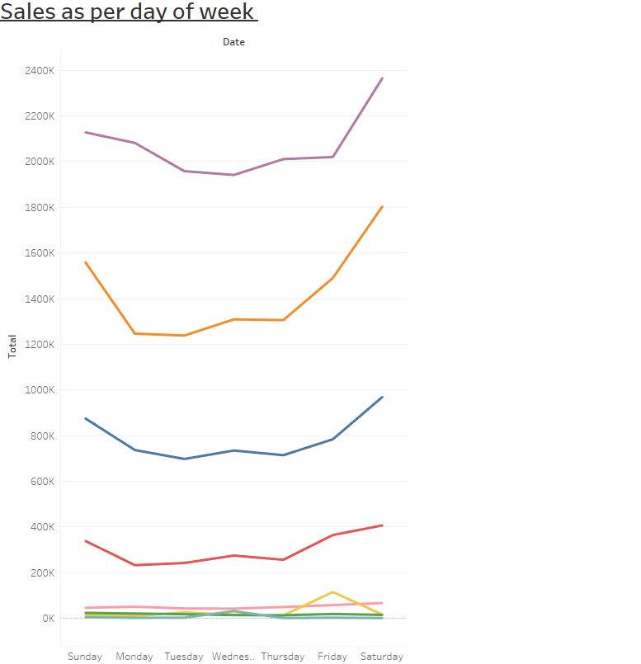
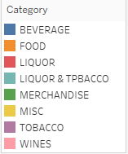
Sales as per day of week
Sales on Sunday is comparatively more than any days
Weekend sales(Saturday and Sunday) are more comparatively to weekdays for Tobacco Category
Sales in Food category food starts increasing from Thursday and weekend

Slide 4
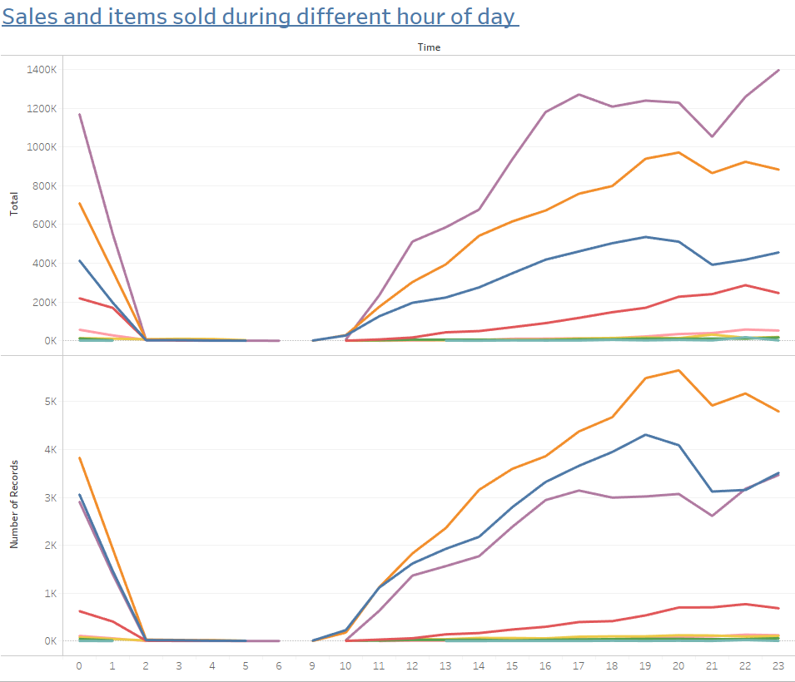
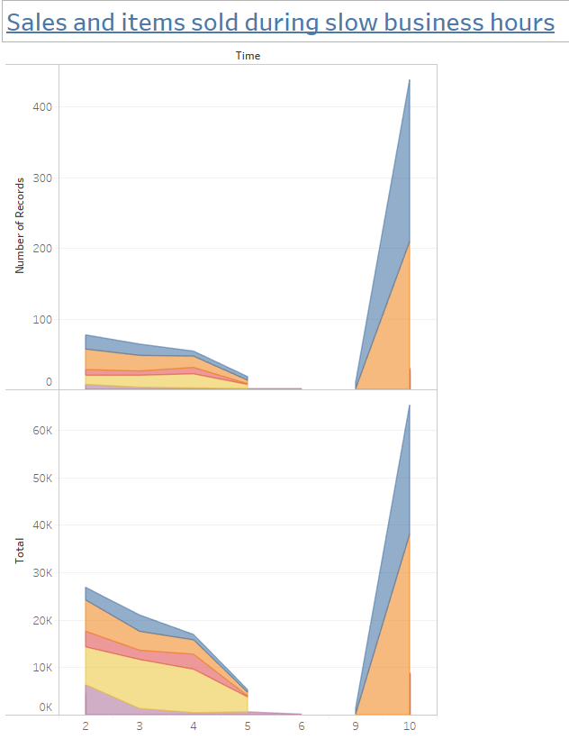
Sales during different hour of day
From 1:00 am to 8:00 am there are no major sales in category
Sharp decrease in sales from midnight onwards
No activities during 6:00 am to 8:00 am during morning hours
Morning hours people prefer food and beverage from 9:00 am to 10:00 am
Night hours misc. items contribute to more revenue from 2:00 am – 5:00 am

Slide 5
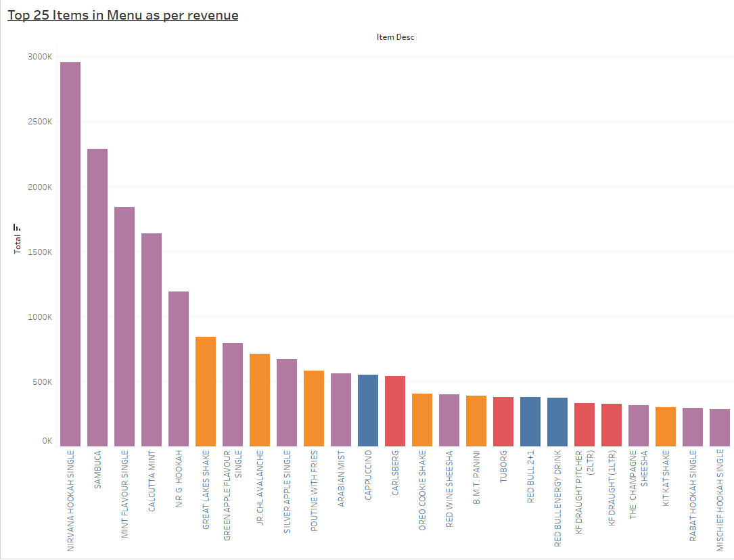
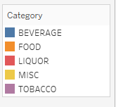
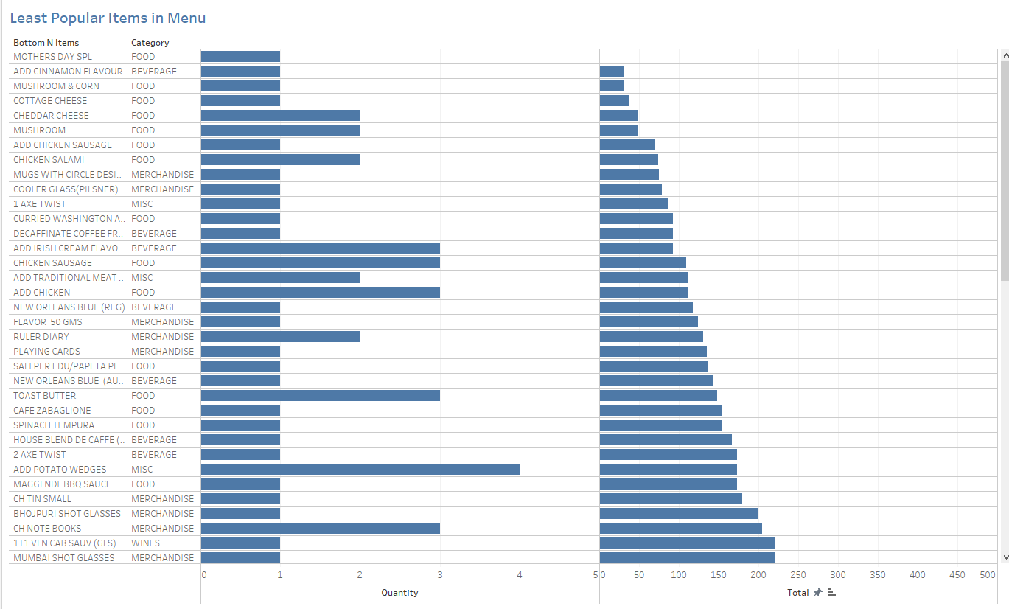
Popular Menu items
Most purchased items are from Tobacco category
Nirvana Hookah single / Sambuca is most item in terms of revenue in tobacco category
Great Lakes Shake and Jr chill Avalanche are in food category
Identified least popular items which sums less than Rs.250 in revenue and orders less than 4 times in year

Slide 6
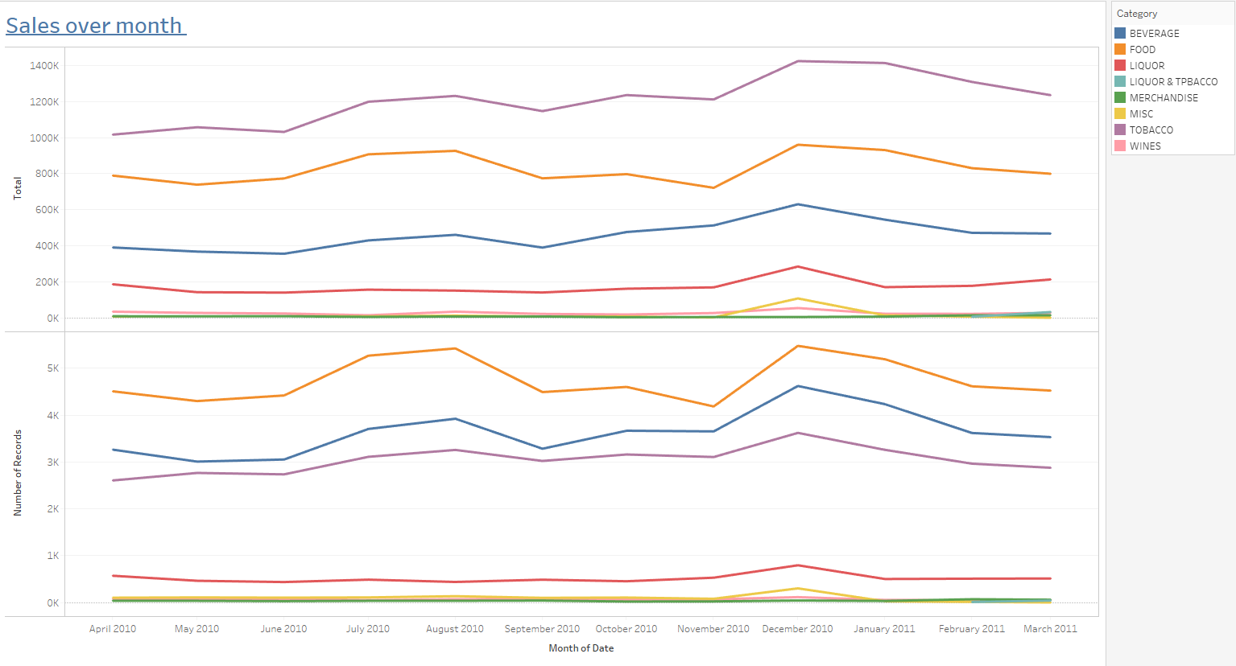
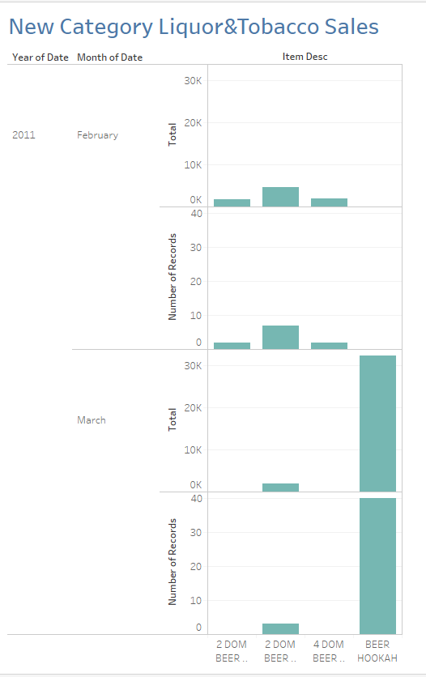
Sales over month
Sales in December month is highest in all Category
Sales Trend show increase from June to August
There is down trend in sales and revenue from August to November month
New Category Liquor & Tobacco added in 2011 Feb & March month
No sales history in 2010 Year under this category
Beer Hookah add 30K+ revenue in a month

Slide 7
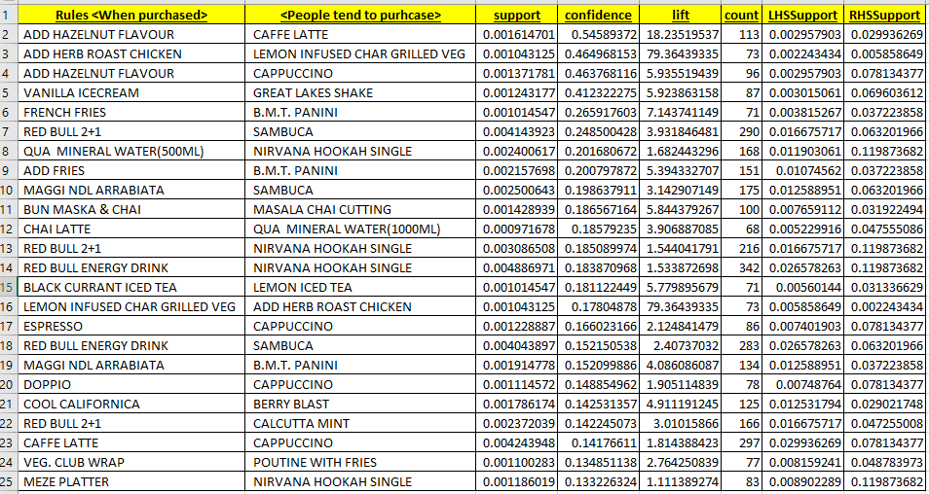
Suggestion For Combo Option:
Market Basket analysis was carried on the entire menu and following TOP-25 combination Menu items can be implemented to boost revenue
High Confidence indicate how frequently the IF-THEN statement are true
High Support indicates item is frequently purchased from the menu
High Lift indicates strong association in rules

Slide 8
Conclusion
Tobacco is the largest revenue category
Food is the most sold item in category
Least sold items which don’t add to revenue or sales can be removed
Top-25 adding revenue items
Sales starts growing at 9:00 am – the operations can be kept closed from 5:00 – 9:00 am
Morning business category are beverages and food items
Saturday is the busy day for week
New item <Beer Hookah> introduced contributed 30+k in a month
During late night hours MISC items sales are on rise
Combo Menu can be recommended to boost revenue

